Slide 1
Neural PSO
A side project by William Boler

Slide 2
Neural Network
Input
Class 0
Class 1

Slide 3
Neural Network Back Propagation
Input
Class 1
Class 1

Slide 4
Neural Network Back Propagation
Input
Class 1
Class 1

Slide 5

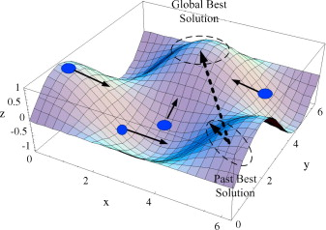
PSO

